Slide 1
Practice Lab:
This Practice Lab is dependent on Discussion Module 7445, where most of the objects we create in this lab were introduced.
This Practice Lab requires a working DSE system, with DSE Search enabled, and with ability to execute CQL DDL.
Because of the dependency on the dsetool utility, this Practice Lab requires a ssh(C) prompt on at least one node operating DSE Search. All other commands are run from CQLSH, or DSE Studio.
DSE Search, Debugging
Notes:
The goal of this Practice Lab is to use a number of the DSE Search validation and debugging utilities introduced in Discussion Module 7445.
Runtime requirements are detailed in the slide above.

Slide 2
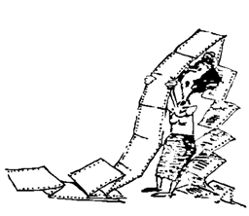
Challenge 1: Reverse Engineer
<fieldType name="nametext" class="solr.TextField">
<analyzer>
<tokenizer class="solr.StandardTokenizerFactory"/>
<filter class="solr.StandardFilterFactory"/>
<filter class="solr.LowerCaseFilterFactory"/>
<filter class="solr.StopFilterFactory"/>
<filter class="solr. EnglishMinimalStemFilterFactory"/>
</analyzer>
</fieldType>
What does this analyzer do ?
Is this an INDEX or QUERY analyzer ?
What happens if a decimal value gets placed in this field ?
Notes:
Using the reference Urls below, reverse engineer what this analyzer does. Be prepared to discuss your findings.
Reference Urls:
https://lucene.apache.org/solr/guide/6_6/charfilterfactories.html
https://lucene.apache.org/solr/guide/6_6/tokenizers.html
https://lucene.apache.org/solr/guide/6_6/filter-descriptions.html
https://lucene.apache.org/solr/guide/6_6/field-type-definitions-and-properties.html
https://lucene.apache.org/solr/guide/6_6/field-properties-by-use-case.html
https://lucene.apache.org/solr/guide/6_6/defining-fields.html

Slide 3
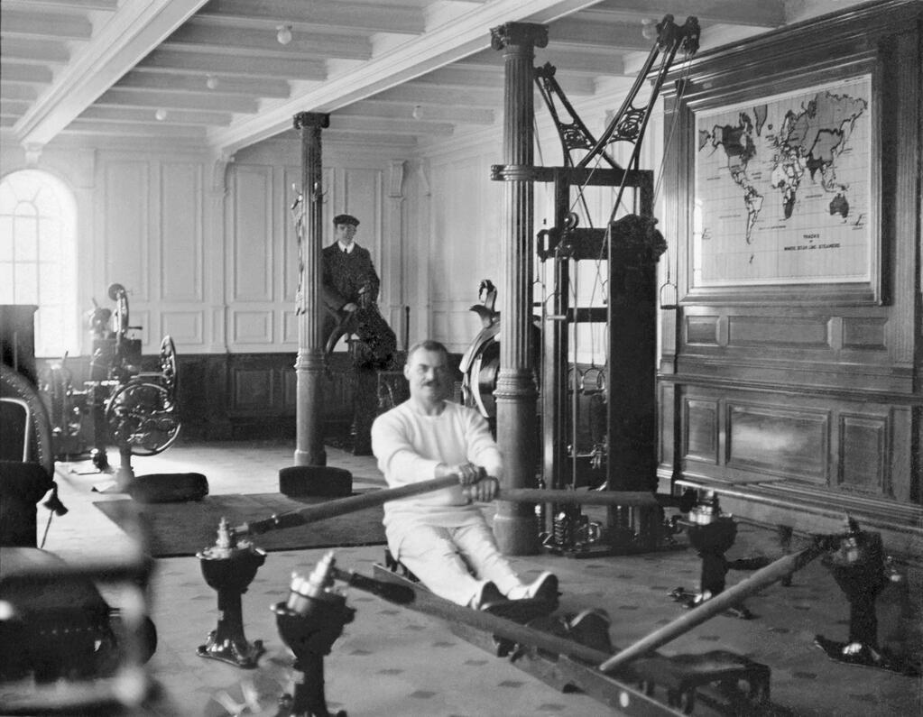
Challenge 2:
Use CQL commands to create, and Solr Admin UI to test (query)
Create an analyzer that returns the DSE table column value “The Cranberries”, when given the query predicate, “anD a kraNBurry”.
More than one analyzer, stage the development incrementally-
A 1st field with just the single tokenizer
A 2nd field with the same tokenizer and just first filter
A 3rd field that adds a second tokenizer
Be prepared to show output values for each stage.
Notes:
Sample syntax above to harvest ideas from in this module and module 7445, apply to the goals outlined above.

Slide 4
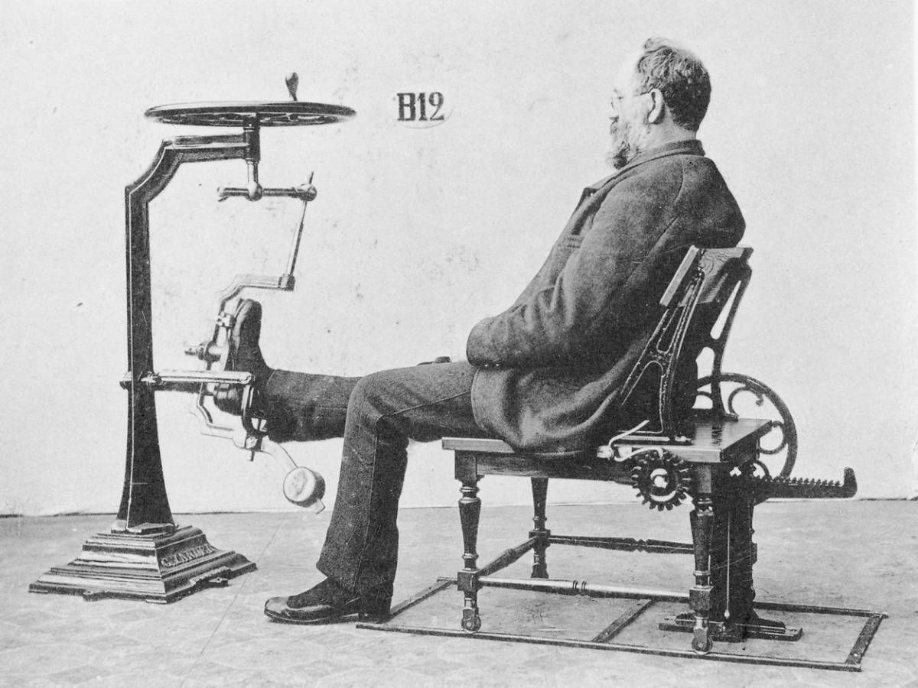
Challenge 3: AND, OR-Topped queries
Use CQL commands to create, and Solr Admin UI to test (query)
Create a DSE table with at least two non-primary key columns, add data
Using these two query strings, and debugQuery
(col3:ddd AND col4:eee)
(col3:ddd OR col4:eee)
be prepared to discuss the differences in the (explain plans).
Notes:
Sample syntax above to harvest ideas from in this module and module 7445, apply to the goals outlined above.

Slide 5

Discussion Lab:
Lessons learned
Notes:
Discuss what worked well, poorly, from the Practice Lab.

Slide 6
End of Module:
Notes:
End of Practice Lab-

